Slide 1


Smart Locks
Team members: Rahul Gorwadkar ( 173074017)
Pratik Sanjay Wagh (173050077)
Rahul Sharma (173050019)
CS 684 Embedded Systems

Slide 2
Problem Statement
Control and monitor locks anytime and anywhere
Locks providing high security with smart features are costly
Key handling issues
Remote location access
Temporary access to those without smartphone.

Slide 3
Requirements
Hardware
○ EPS8266 Board with WiFi Module
○ Electrically operated Solenoid based Lock
○ Accelerometer Sensor (MPU6050)
○ Power Supply : 5V
○ Relay Module
○ Android Phone

Slide 4
Requirements (Software)
Software
Android - Studio
AWS (DynamoDB, Cognito, IOT Core, MobileHub)
Arduino IDE

Slide 5
Project Plan
We divided the work in two parts :-
Android Development and its connection with aws and aws iot.
Knocking Pattern Detection, Connection of esp8266 with aws iot.

Slide 6
Project Plan
Title Of the Work | Work done by | Date of Completion | Critical Tasks
Android Development | Pratik Sanjay Wagh | 20th March 2018 | Adding features such as Navigation Drawer and creating a different view for master and slave user
Connection of Android Application with aws and aws iot | Pratik Sanjay Wagh and Rahul Sharma | 18th April 2018 | Connecting an android app with aws cognito, aws dynamo db and aws iot. Fetching and inserting into the above service.
Knocking Pattern Detection and Connection of esp8266 with aws iot | Rahul Gorwadkar | 18th April 2018 | Faithful Knocking Detection, ESP8266 and AWS interface with SDK without using Mongoose OS

Slide 7
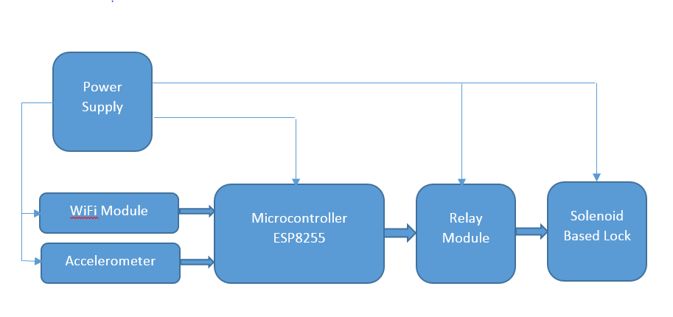
Block Diagram

Slide 8
Block Diagram (Description)
Power Supply :- Power supply of 5V and 12V is used to drive the micro-controller and the solenoid based lock.
Relay Module :- It act as a switch to lock or unlock the door. It is connected to the ESP8266 module and the physical lock.
Solenoid Based Lock :- It is a physical lock which creates a magnetic field when current is allowed to pass through it. In our case the flow of current is controlled by the relay module.

Slide 9
Block Diagram (Description)
Microcontroller esp8266 with Wifi Module :-An ESP8266 Board with wifi module is used which acts as the core of the lock. It contains the pins configuration code and the knocking detection logic running in it. It is also connected to the accelerometer that provides the data whenever a knock is detected by the accelerometer. It is also connected to the relay module to signal the lock to unlock.
Accelerometer:- MPU6050 sensor is used to detect the knocks on the door. It transfer data to the microcontroller.

Slide 10
Innovation and Challenges
Integration of Android Mobile Application with the AWS IOT.
Generating random knocking pattern everytime to ensure security.
Achieving high accuracy in sensing the stimulus from environment using accelerometer(ADXL 312)
Keeping the development cost low.
Integration of Hardware device with the cloud.

Slide 11
Task Completed
Created an Android Application with different privileges for master and slave user.
Adding new features such as Navigation Drawer, RecyclerView was a problem and were solved by youtube tutorials
Connected an Android Application with AWS DyanmoDB, AWS Cognito and AWS IOT.
No proper documentation for connecting an App with AWS services. This problem was solved by the sample codes provided by AWS

Slide 12
Task Completed
Successfully implemented algorithm for faithful Knocking Detection
Accelerometer noise was suppressed using software filter implementation for faithful knock detection
Successfully established connectivity between ESP8266 and AWS DynamoDB
ESP8266AWS SDK is in developmental phase and lot of issues in SDK could be solved by accessing forums on relevant topic

Slide 13
Test Strategies
Testing the lock with multiple duplicate users.
Ensuring proper authentication of users while login in.
Testing the lock using correct and incorrect knocking patterns with different impulse on the door at different locations to ensure the sensing range of the MPU6050 sensor.
Maintaining log of all types of users

Slide 14
Re-usability features
Android Application can be used to access the cars, some gadgets
Our knocking pattern code is modular so it can replaced with face recognition method, voice recognition method to unlock the door.

Slide 15
Future Enhancement
Mounting an led in the door which glows in interval of 1 second to make it easier for user to keep note of time interval between two consecutive knocks.
Adding a buzzer which blows an alarm if more than 5 incorrect knocking pattern is detected and also if lock is accessed using unwanted physical means.
Unlocking the lock can be done by using music pattern, face detection method, voice recognition methods

Slide 16
Thank You
Thank You

